Slide 1
Becoming a manager Lori Conlan, PhD conlanlo@mail.nih.gov

Slide 3
Ground Rules
Avoid side conversations
Goal is to be open and honest
Avoid being judgmental
Practice active listening
Mind your E-I manners
Do not dominate the airwaves – in small or large group discussion
Do not sit back and avoid sharing

Slide 4
Group Work – the Story of RT and PJ
After receiving good, but pretty critical, reviews to a paper we submitted to JCB, RT, a grad student in my lab, did not start working on the revisions quickly enough. I called RT in and made it clear that if we missed the 90-day deadline the editor would reject the paper outright. I said we would be embarrassed at the next thesis committee meeting and in front of the whole department. I was forceful in my assessment of the situation, and negative about potential outcomes. This approach worked well; RT started experiments immediately, worked hard and finished the revisions in record time. Although RT seemed hurt and irritated at first, it didn’t last and the paper got accepted, making everyone happy.
Another grad student PJ had similar work focus problems related to scheduling a required thesis proposal meeting and department seminar. I used the same direct and forceful approach of pointing out how embarrassed we would be. Although the approach worked well with RT, PJ responded by disappearing, calling in sick, and avoiding me. We had some really awkward interactions until we finally talked about it; then I learned about many other issues in our relationship that I was completely unaware of. Unfortunately, it was too late to salvage things and PJ moved to another lab, leaving me short staffed at a critical time.

Slide 5
What did the manager do right?
What did the manager do wrong?
What variables/factors might have impacted the outcome?
What lesson should the manager have learned?

Slide 6
Potential Issues and Variables
Differences in….
communication style
openness to feedback
how people are motivated
response to stress and/or setback
People at different stages or need different amounts of hands-on guidance
People might have been impacted by other messages delivered by the boss in the past
Personal issues could be playing a role for one of the person and not the other
Keeping in mind that culture and/or gender differences, biases and/or assumptions could be at play

Slide 7
Managers Help Others Get Work Done By:
Motivating them
Providing direction
Promoting teamwork
Removing roadblocks
Giving feedback
To prepare to manage, you must carefully consider how you do/wish to do each of these important elements

Slide 8
Journaling Exercise
What makes you happy at work?
What makes you unhappy at work?

Slide 9
Journaling Exercise
What makes you happy at work?
What makes you unhappy at work?
What can we learn from this exercise?

Slide 10
Journaling Exercise
What makes you happy at work?
What makes you unhappy at work?
What can we learn from this exercise?

Slide 11
Developing a Foundation for Leadership:
Learning management principles and theories
Understanding and managing ourselves
Understanding our colleagues, co-workers, employees, students, boss(es), and the environment we work in
Developing our communication skills and ways of interacting with all of the individuals and organizational systems we need to interact with

Slide 12
The Story of PP
Read the scenario, then discuss what the manager did right, what the manager did wrong, variables and factors that you feel are important to the story, etc. Be prepared to briefly report out on your discussion.
There are three scenarios:
Group 1 and 2: PPI
Group 3 and 4: PP2
Group 5 and 6: PP3

Slide 13
PPI
I was very excited to hire a very new administrator (PP) to help manage the training programs I was directing at the time. PP was junior, just out of a postdoc and transitioning to their first job, but I received stellar recommendations. I hoped PP would hit the ground running; however, I had some concerns about whether they would be able to manage the many programs, budgets, students, and faculty I needed them to manage. When PP arrived, I went over everything in-depth and tried to provide a lot of guidance; however, they seemed a bit “put off” by my hands-on approach. I thought that perhaps my hands-on approach was insulting so I backed off and gave PP a lot of independence assuming they would come to me with questions. Unfortunately, this did not happen. I started to realize how many poor decisions PP was making but I felt uncomfortable giving such negative feedback and I just let it go. Things got so far along that by the time we talked in detail, things were really frustrating for both of us. We both wanted it to work out, and did try to hit the re-set button after several months, but in the end, PP resigned and took a similar job across campus.

Slide 14
PPII
I was very excited to hire a very senior administrator to help manage the training programs I was directing at the time. PP came with stellar recommendations and many years of experience in student services, so I knew they would hit the ground running and would be able to manage the many programs, budgets, students, and faculty I needed managed. When PP arrived, I did not spend a lot of time showing them our systems or talking in detail about our programs because I did not want to imply I did not trust their expertise or insult them by being a “micro-manager” (and my preferred style is to be very hands-off anyway). I guess we never really talked about fundamental issues in our programs and we often found ourselves setting different priorities and miscommunicating. Early on I missed several opportunities to redirect PP’s energies on complicated projects. Things got so far along that by the time we talked in detail, things were really frustrating for both of us. We both wanted it to work, and did try to hit the re-set button after several months, but in the end they resigned and took a similar job across campus.

Slide 15
PPIII
I had an incredible employee (PP) who I promoted from a staff position to senior program manager in the training office I direct. PP worked for me for over 5 years and always did stellar work. The new job involved managing many programs, budgets, students, and faculty committees and was a major increase in responsibility. On top of taking on new responsibilities, PP was going to begin managing some former peers. I was confident things would go well and did not give much thought to the transition. After a few months, my boss pulled me aside and mentioned that many faculty and students had raised concerns about my office and specifically about the new administrative leader. I was shocked, but as I started looking into the situation, I learned that PP and I had very different ways of managing conflict, dealing with faculty and supporting students. I also found that we had different priorities and goals for the office. When we finally sat down to talk about all that had transpired, it was too late to make it work. One month later PP resigned and took a similar job across campus.

Slide 16
Hersey and Blanchard Situational Leadership Theory
Suggests that successful managers and leaders adjust their styles, depending on the situation
No one style is inherently better
All have their time and place
Goal is to be flexible and aware enough to use the right style at the right time
Characterizes management styles in terms of the amount of direction and support that the leader provides to their followers
four styles based on the relative emphasis on directive vs. supportive behaviors

Slide 17
Two Types of Behaviors
Directive behaviors (task focused)
Involves clearly telling people what to do, how to do it, when to do it and then closely monitoring behavior
Supportive behaviors (relationship focused)
Involves listening to people, providing support for their efforts, and then facilitating their involvement in problem-solving and decision making

Slide 18
Hersey-Blanchard Leadership Model
High
Participating
Share ideas
Selling
Explain decisions
Supportive behaviors
(focus on relationship)
Delegating
Turn over decisions
Telling
Give instructions
High
Directive behaviors
( focus on task)

Slide 19
What Are The Take Home Messages?
It is not a conveyor belt
People can need one level of oversight and guidance for one task and a very different level of oversight and guidance for another
It is not only skill level, but also their level of confidence
If we delegate, we have to accept the decisions of the individual without expecting them to do things our way
The more intentional and transparent we are, the more employees will respond to our decision about our level of engagement with acceptance

Slide 20
Bosses Wear Many Hats
Supervisor: responsible for making sure work gets done
Coach: teach individuals specific skills important for advancing our work and their career
Mentor: responsible for broadly developing and supporting the personal and professional ne an individual
Advocate: speaks up on behalf of an individual’s career advancement
http://www.management-mentors.com/resources/coaching-mentoring-differences/
http://www.nytimes.com/2013/04/14/jobs/sponsors-seen-as-crucial-for-womens-career-advancement.html?_r=0

Slide 21
Important Questions
In many work environments, one’s supervisor typically also functions as a coach/mentor/advocate as well.
What are the benefits of this approach?
What are the risks?

Slide 22
Risks
Employees do not always feel safe disclosing to their boss
The needs of the employee and the boss do not always align well
Time constraints often limit quality of mentoring interactions and work comes first
Sometimes the supervisor lacks (or is perceived to lack) of expertise and experience in specific areas relevant to the employee

Slide 23
Small Group Discussion
Some things to think about:
As managers, can we assume that we can provide all of the coaching and advocacy our employees need?
As managers, why should we care whether individuals have mentorship and sponsorship in the workplace?
And a longer discussion:
What are some general strategies and approaches we can use to minimize the conflict between our supervisory and mentoring roles?

Slide 24
Some General Strategies
Embrace the concept of multiple mentors
Encourage the use of training/support resources in your organization
Hold different mentoring meetings and work meetings
Develop a framework for dissecting specific tensions between organizational/unit work needs and the employees needs
Look both short- and long-term
Examine risks and rewards
Try to see the situation from your employee’s viewpoint
Get advice when the stakes are high

Slide 25
Final Thought
One last hat – friend – is associated with a lot of risk to you and your group
it can be very hard to correct a friend
favoritism can become an issue very quickly
risks to the work relationship when the friendship sours

Slide 26
Emotional Intelligence

Slide 27
Emotional Intelligence
“The subset of social intelligence that involves the ability to monitor one’s own and others’ feelings and emotions, to discriminate among them and to use the information to guide one’s thinking and actions”
Jack Mayer & Peter Salovey, 1990 http://www.unh.edu/emotional_intelligence/
“The capacity for recognizing our own feelings and those of others, for motivating ourselves, and for managing emotions well in ourselves and our relationships”
Emotional Intelligence: Why It Can Matter More Than IQ, Daniel Goleman

Slide 28
Long-term Goal
Improved interpersonal relations
Better management
Increased awareness

Slide 29
Four Domains of EI
Knowing your emotions
Recognizing & understanding emotions in others
Self-awareness
Social awareness
Self-management
Relationship-management
Managing your emotions
Working with the emotions of others

Slide 30
Elements of Emotional Intelligence
Self-Awareness: Recognizing your own emotions Knowing your triggers and hot buttons Understanding your personality, communication, conflict and work styles Accurately knowing your skills and developmental needs | Social Awareness: Accurately reading the emotions of others Having empathy for others Understanding your organization Having a service orientation
Self-Management: Controlling negative emotions Managing stress Having/conveying self-confidence Acting with integrity Dealing with setback (optimism) Being appropriately driven Being flexible and adaptable Controlling edges in personality, communication, conflict and work styles | Relationship-Management: Exerting influence and motivating others Promoting teamwork and collaboration Being an inspiring leader Developing others Developing active listening skills Promoting inclusion of diverse individuals Dealing effectively with conflict and difficult conversations
With modifications from http://www.eiconsortium.org/

Slide 31
Self-Reflection and Discussion
Which of these EI competencies will be most important for you as you make the transition to manager?
What are your EI strengths? What about your least developed competencies?
What are some examples that highlight these?
Get into pairs; each person will share for five minutes.

Slide 32
Developing our EI Competencies
We learn by doing, reflecting, learning and re-doing; find ways to facilitate that process.
Books, blogs and videos
Workshops and courses (institutional resources!)
Share experiences with peers
Put yourself in situations that give you practice
Talk with career/management mentors
Journal about your experiences (http://wisdomcouncils.com/wordpress/?p=239 )
Establish relationships with coaches and counselors

Slide 33
Scenario for Discussion
You have had a LOUSY day. You woke up to a sick dog and had to clean vomit off your new (expensive rug), you briefly argued with your partner about it, and Metro delays caused you to miss an important meeting with your boss. You finally got settled at work and then you got called to an emergency senior staff meeting. You came back from the meeting around 1:00 and found your technician surfing the internet again. There were deliveries stacked up by the door, orders piling up on the order board, and it is clear that other work they were supposed to attend to today was not dealt with. This behavior follows on the heels of a discussion several weeks ago where you talked about their time management skills and work ethic. You are really stressed about a talk you are giving next month and a progress report due to your supervisor shortly afterward and you need to have a productive month. This behavior really pushes your buttons and you have had enough –
WHAT NEXT?

Slide 34
Same Scenario With a Twist
You have had a LOUSY day. You woke up to a sick dog and had to clean vomit off your new (expensive rug), you briefly argued with your partner about it, and Metro delays caused you to miss an important meeting with your boss. You finally got settled at work and then you got called to an emergency senior staff meeting. You came back from the meeting around 1:00 and found your technician surfing the internet again. There were deliveries stacked up by the door, orders piling up on the order board, and it is clear that other work they were supposed to attend to today was not dealt with. This behavior follows on the heels of a discussion several weeks ago where you talked about their time management skills and work ethic. You can’t believe what you are seeing, and you let them know (loudly and somewhat aggressively) that you have had enough. The discussion does not go well at all and the two of you finally agree to take a break and talk later. What do you do next?

Slide 35
In Closing (soon)
You have the potential to impact the future of science by developing outstanding management and leadership skills
It takes A LOT of resilience, time, commitment, humor and willingness to change to develop these skills

Slide 36
Let’s Try Journaling
Write about something you learned today- why it grabbed your attention and what you want to do moving forward to learn more.

Slide 37
What is Resilience?
The process of adapting well in the face of adversity
Resilient people “bounce back” and learn from the adversity; they are stronger for the setback
Resilient individuals work to develop
self-awareness and emotional intelligence
an appropriate level of optimism
strategies for rebutting “negative head-tapes”
a network of supportive and caring individuals
self-care strategies

Slide 38
Key Concept
Organizational resilience matters too!
The way to build organizational resilience, is to
Develop your own resilience
Help your staff develop their resilience
This often means working against the prevailing work culture
https://hbr.org/2011/06/building-a-resilient-organizat

Slide 39
What is Self-Care?
All the things we do (and don’t do) to maintain our physical, mental, emotional and spiritual health
There are common themes, but we all have unique ways of “tuning-in and taking care”
A requirement, not a luxury, if we wish to avoid burn-out (for ourselves and our staff)
BURN-OUT: A state of physical, emotional and mental exhaustion from work. Leads to a lack of motivation, low efficiency and a feeling of helplessness.

Slide 40
Communication (& Conflict) ..we need to talk….

Slide 41
Take a moment and list some conflicts that you have had in the workplace
Then list conflicts you have seen managers have to deal with
Notes:
Can they then group their conflicts to check for hot buttons?

Slide 42

What is good communication
Everyone says communication is good management…but what is good communication?
In your group discuss good communication and come back with 3ish concrete tips that you can use as a manager to communicate
Notes:
Non-judgemental, trust, open, sincere, approachable

Slide 43
Communication is also listening
Active listening– listening to what others are saying without thinking of how you will respond, or predicting what they may say.
How do we actively listen?

Slide 44
Listening tools
Encourage: Invite the speaker to share
Clarify: Ask questions to confirm you understand
Restate: Repeat in your own words what you have heard
Reflect: Explain what you think the person is experiencing
Summarize: Reiterate ideas, themes, and feelings expressed
Validate: Show appreciation for the person’s effort to communicate
And using non-verbal communication to convey that you are paying attention and that you care.

Slide 45
Giving feedback
How is feedback given?
-positive vs. constructive?
Positive 5x more than constructive
Immediate recognition
Be specific
Don’t sandwich with constructive
Public recognition
Non-verbal communication (97% of what is “said”)

Slide 46
Three General Types of Feedback
Appreciation Feedback
to motivate and encourage
Coaching Feedback
To change the way someone does something and to help increase/improve knowledge, skills or abilities
Evaluation Feedback
To let someone know where they stand and to address/clarify expectations
We are all different in how we respond to feedback and in the types and amount of feedback we wish to receive
Frustration can happen when we want one type of feedback and get another

Slide 47
What Tends to Get in the Way
Stress response
When faced with a threat, we tend to react using our flight, fright, freeze response
Cognitive distortions
Triggers
Truth: someone questions the accuracy of the feedback
Relationship: someone is triggered by the person delivering the feedback or questions their knowledge/expertise
Identity: someone struggles to receive feedback because it challenges their view of self in important ways
Thanks for the Feedback: the Science and Art of Receiving Feedback Well; Stone and Heen

Slide 48
Triggers and Hot Buttons
Events, words, phrases, situations, or a combination of these that cause a negative emotional reaction
Are very individual and conditioned by our life experience
We all need to be aware of our triggers and then take steps to deter the triggers from causing behaviors that undermine our leadership
Knowing what triggers our employees and colleagues can also be helpful

Slide 49
How do these fit your hot buttons?
Unreliable- missed deadline
Over analytical-focus on minor issues/perfectionists
Unappreciative- fail to give credit or praise good performance
Aloof-isolate themselves or are hard to approach
Micro-manage- constantly monitor/check in on progress
Self-centered- always correct/ all about them
Abrasive- arrogant/sarcastic/demeaning
Untrustworthy- exploit others/cannot be trusted
Hostile- lose temper/yell/anger
From Conflict Dynamics Profile

Slide 50
Think about a time
When your hot button was pushed
What was the situation
Who was involved
What was the hot button
What conflict style were you in
What conflict style was the other person in
How do you act—what is your stress response?
How does your default stress response impact others?
How does/would this limit your effectiveness as a manager?
What could you do differently?

Slide 51
Person who will receive feedback does a self-assessment (of the task or period of work):
What 3 things would you say worked out best?
What 3 things worked least well?
Manager provides feedback (may be the same as self-assessment or different):
Here are the 3 things I would say worked out best.
Here are the 3 things that worked least well.
Find out the Effect of the Feedback:
How does this feedback compare with your own perception?
Tell me your interpretation of my feedback to you.
What are We Learning:
What would have happened if _________? What would have been a better outcome?
What help did you need? What help did you solicit? When did you first see you needed help?
What kept you from getting the help you needed?
What could I (manager) have done differently?
What Can You Learn Going Forward:
If you could plan this all over, what would your plan be?
If you could do the thing all over, what would you do differently?
Joanne Kamens: http://blog.addgene.org/management-for-scientists-giving-feedback

Slide 52
Constructive and Destructive Approaches
Constructive
Calm and respectful language
Appropriate body language (tuning-in)
Acknowledging emotions
Allowing others to speak
Using paraphrasing to ensure you understand
Asking helpful questions
Delaying responses if you are angry or upset
Destructive
Yelling and threatening
Using threatening body language
Talking over others
Being sarcastic
Demeaning others (or the process)
Dominating the airwaves
Saying one thing and meaning another

Slide 53
Reframe
Change the way you see a situation
Recognize
Hot buttons, stress response
Reframe
Separate facts from narrative
Reflect
Did that work? Were you more satisfied?

Slide 54
Active Responses
Perspective taking
Work to understand the other person’s view and to examine the weaknesses of your own position
Creating Solutions
Come up with solutions together
Expressing Emotions
Explain how you feel and why
Reaching out
Follow up, admit responsibility and make amends

Slide 55
Passive Responses
Reflective Thinking
Carefully review alternative reactions and their pros and cons
Delay Responding
Call a time-out when tensions or emotions interfere with problem solving
Adapting
Focus forward and adapt/accept

Slide 56

Work thru scenarios

Slide 57
Feedback flip
How can you encourage your staff to give you feedback on how you are doing?
Ask direct questions in non-public settings
Have regular 1:1 meetings
Seek feedback in multiple formats
Anonymous options
Actively listen
Make change if possible
http://blog.addgene.org/management-for-scientists-what-makes-a-good-manager-anyway

Slide 58
Q-tip
Quit Taking It Personally

Slide 59
Day 2 OITE Management Bootcamp
Notes:
Human resources are important AND costly!
A good hire can move your group to a new level; a hiring mistake can be devastating.

Slide 60
On an index card write your key take-away from yesterday
Walk around and try to find colleagues with similar themes
In your group share your thoughts on the importance of your take-away theme
Have one person be prepared to share with the whole group

Slide 61
Interviewing and Staffing
Notes:
Human resources are important AND costly!
A good hire can move your group to a new level; a hiring mistake can be devastating.

Slide 62
Today’s Agenda
How to hire
Advertising the position
Reviewing CV/resumes
Interviewing
Checking references
Creating a consistent process

Slide 63
You are not alone!
75% have hired the wrong person*
Estimated cost, $15K
Other costs
Drains resources
Lowers productivity
Demotivates current staff and/or lab members
Distracts supervisor/PI
*Careerbuilder survey, 2017
Notes:
So why does this happen?

Slide 64
The Process
Analyze your needs*
Create a job description
Advertise/recruit
Screen the candidate pool
Interview*
Check references*
Decide*/make an offer
Review the process*

Slide 65
What Does HR Do?
Ensure that you comply with “company” policy
Position titles and levels?
Salaries?
Benefits?
Process?
Notes:
Talk here about how this differs in industry, academia and government. Do we want to move grant-supported positions here too (fromslide 8?)
At the NIH, all of this is highly structured. Jobs are organized in series. For example, the 601 series is for scientists who are using their science skills in their jobs.
The General Schedule (GS) has 15 grades and 10 steps within each. Salaries are specified for each.
Criteria for each grade are series-specific. That means that , e.g., when OITE wants to hire someone, we have to work closely with HR to make certain that the job description we write will be assigned the GS level we want.
Veterans have absolute preference in the Federal government.
University – EPA and SPA – RIF employees has first priority for SPA positions. In some industries – existing employees have first priority.

Slide 66
What Do Employees Cost?
Salary—do you know current levels?
Add about 20-30% of the salary
Social Security: 6.2%
Medicare Tax: 1.45%
Unemployment tax: varies by state
Retirement: 2.5-5%
Health Insurance: $5K-$15K
Tuition: $5K-$20K
Then there are the costs of the actual work
Notes:
Employees will generally cost more than their salaries.
You may need to choose the level you can afford or the most cost-effective way to get what you need.

Slide 67
Create a Job Description
Title, business unit, organization*
Compensation, location
Responsibilities, tasks
Reports to
Background required
Education
Experience
Skills
Personal characteristics desired
How to apply: documents required; deadline
Notes:
You need to take the time to do this well. If you say you are looking for a PhD and you later find an MS-trained individual who is perfect for the position, you will not be allowed to hire him/her.
Always included the statement - and other duties as assigned…..
Is there a danger in over-specifying?

Slide 68
Consider Including a “Company” Profile
Supervision: hands on/hands off
Structure: hierarchical/flat/flexible
Interdependence: team based/individualistic
Pace: fast-moving, innovative/stable, solid
Approach to risk: embraced/managed
Decision making: top-down/participatory
Valued Traits: creativity/dependability/loyalty
Roles: well-defined/flexible

Slide 69
Advertise
How wide a net?
Internal vs. external candidates
Local vs. nationwide search
Where? Find out what current employees read
Consider the following:
Newspapers online Minority publications
Professional societies Organization Web site
Social media
Get your employees and network involved
Notes:
Many companies offer bonuses for employees who identify new hires.

Slide 70
Evaluating Candidates
How do you screen CV/resumes?
Competencies
Technical skills
Coursework
GPA
Motivation for science
Team fit
For Postdoc candidates- a paper or two
Be careful of being overly impressed/unimpressed by particular schools/majors
For Postbacs-- be careful of good candidates in the system longer than a few months, they might be taken.

Slide 71
Assessing Applications
Compelling candidate emails must show:
They have read your research
They are enthusiastic about your work
They have the skills to fit in
Research topic similar/connected
Technique needed
Question---what if they want to switch fields?? Should you consider them???

Slide 72
Weed thru Candidate Emails
Ignore all of them (not possible or professional)
Send an email back
Thanks—but not hiring (a form email you can send anyone)
If compelling, a follow-up email describing potential projects, your group style, and requesting they read a recent paper of your group and describe how they would add to the project

Slide 73
Assess Candidates via Competencies
The identified set of knowledge, skills, abilities, and behaviors needed to perform a job in your group
Generally grouped as:
Skills, knowledge, and technical competencies
Behavioral characteristics and personality attributes which typically lead to success given the type of work done in your group
Can be ranked along a continuum from baseline level to full mastery
Should be ranked according to how important each competency is to us (for that specific hire)

Slide 74
Example - Western Blots
LEVEL 1 | LEVEL 2 | LEVEL 3 | LEVEL 4
Learned about western blots in class and in a structured lab | Has performed western blots with supervision and oversight | Routinely performs western blots with little supervision | Routinely develops new approaches for western blotting
Can explain basic idea but lacks in-depth knowledge of the technique; would need help in troubleshooting | Has in-depth knowledge with some noted gaps; could do basic troubleshooting on own | Has in-depth knowledge; likely able to extensively troubleshoot with minimal input | Has in-depth knowledge; able to develop new approaches and extensively troubleshoot
Not able to teach or supervise others | Could explain basic concepts and provide minimal oversight | Can teach and supervise others but may need help at times | Could serve as technical expert for the group

Slide 75
Example – Independent Learning
LEVEL 1 | LEVEL 2 | LEVEL 3 | LEVEL 4
Has not yet demonstrated ability for independent learning | Has demonstrated ability for independent learning with coaching | Has demonstrated ability for independent learning | Highly adept at independent learning in the past
Has little awareness of resources for relevant learning | Can describe some resources for relevant learning | Can describe many appropriate resources for relevant learning | Expresses a well thought out plan for relevant learning
Does not seem to value independent learning at this career stage | Seems to somewhat value independent learning | Expresses enthusiasm for independent learning | Expresses enthusiasm for independent learning and guiding the learning of others

Slide 76
Some Thoughts on Competencies
Focusing too many competencies on specific technical skills can be risky, especially when we have a small group
The earlier the career stage, the more critical it is not to focus on technical competencies
Competencies need to address inter-personal and communication skills

Slide 77
Interview Planning
Consider a structured interview: “a series of job-related questions with predetermined answers that are consistently applied across all interviews.”
Design the questions: a 3-part process
What qualifications do you want to asses? How would strong and weak candidates differ?
What questions will elicit relevant information on those qualifications and differences?
What would good answers look like?
Notes:
What would be the advantages of using a structured interview process?
Fairness
Ease of comparing candidates

Slide 78
Interviewing
Candidates are asked the same set of questions
Questions relate to competencies
Questions ask for concrete examples of what the applicant did in the past
Do a zoom screening of the top candidates.
Each interview is time limited and consistent
For zoom/phone interviews 20-30 minutes is plenty
Have others join you: Group interviews can be used to help rule-out in-group/out-group biases and to assure that everyone hears the same thing

Slide 79
Opportunity Questions
Tell me about a time…..
How do you approach…..
What do you typically do when …..
Give me a sense of……
Explain some challenges you have had with……
Please discuss an important…….
Why the NIH…
What are your career aspirations...
What is the last paper you read……
How do you talk to non-scientists about your work?
Which of our papers did you like best, and why?

Slide 80
More Questions
Why are you interested in this specialty/discipline?
Why are you interested in this particular program?
What are your goals/career intent and how do you see this program preparing you for these goals?
What is the hardest feedback that you ever received, and what did you do with it?
Describe a research experience. What would you have done differently with hindsight. What unknown bothered you?
Clinical Fellows
Tell me about a challenging case in which you were involved.
Did you ever witness something—a clinical situation or personal interaction—that made you uncomfortable? What did you do about it?

Slide 81
Behavioral Questions
Tell me about a time when you:
disagreed with something a boss asked you to do
disagreed with another member of a team you were on
had more projects than time
when you had to learn a new technique
realized you made a big mistake in one of your experiments
were proud of yourself in lab (or a lab class or in the clinic)?
were disappointed in your performance in a class or in lab or in the clinic
had a [writing] project that felt a bit overwhelming at the start
Mistakes are opportunities for growth – but we have to be smart enough to learn from them. What does this mean to you?
What comes to mind when someone says “toxic work environment?” What about “a welcoming and affirming work environment?
What are you looking for in this experience? ..in a mentor?
What does an ideal research environment look like for you?
What do you want to learn?

Slide 82
Questions You CANNOT Ask
Federal Laws prohibit employment discrimination based on: race, color, religion, sex, national origin, age, disability, and genetic make-up.
Employment includes: compensation, transfer, promotion, layoffs, recruitment, training, fringe benefits, retirement, etc.
The Equal Opportunity Employment Commission (EEOC) enforces the laws.

Slide 83
The Bottom Line
You CANNOT ask anything directly or indirectly related to race, color, religion, sex, national origin, age, disability, or genetic make-up.
The safest approach: ask ONLY questions that will elicit information you can use in making an informed hiring decision.
Seriously consider drafting questions in advance.
Do not chat!

Slide 84
What about These Questions?
“Sokolove”, that’s an interesting name. Where does it come from?
Do you remember the original Bandstand? Am I correct that it originated in Pittsburgh?
I see that you list Little League as a volunteer activity. Does one of your children play?
Do you speak fluent Spanish? (if relevant to the job)
Are you a U.S. citizen?
Will your child-care arrangements permit you to…?
Will you be able, occasionally, to work late or on weekends?

Slide 85
References
Lots of issues
Letters are likely to omit or understate issues
Conversations are also not likely to be totally truthful but you have a better chance of following up
You should ask things to confirm or refute interview responses
Speak with more than one person for critical hires
Disconnect between your assessment and the reference’s input? There are explanations and you should follow up with others

Slide 86
Some Questions for References
Would you hire this person again?
Do they listen? Do they ask questions?
Are they open for feedback?
Can you trust them?
Alone, to show up?
Are they a good group citizen?
Are they shy or assertive?
What can I do to help this person be successful?
Any red flags I should know about?

Slide 87
More Reference Questions
How long and in what capacity have you known the,?
What are their primary strengths?
What are their writing skills like?
Are they a good communicator and listener?
What about their analytic skills?
Do they show the beginnings of independence?
Are they committed to her research work?
In the transition to postdoc, is there any area in which they may need additional support in order to flourish?
If you had the opportunity to extend their stay in your group, would you?
How many predocs have you directly mentored?
Of all of the doctoral students you have mentored, how would you rate on a scale of 1-10, with 10 being the highest?
Is there anything final you would like to add?

Slide 88
Give Them References
Allow the candidate to talk with past group members to figure out if your philosophies/style will work for them

Slide 89
Some Thoughts on On-Boarding
Be clear about expectations
We tend to jump into work too quickly
Direct trainees to OITE website and resources at the outset
Trainees encouraged to balance training and work in a healthy way tend to stay, even when the “going gets tough”
You need to ask how things are going – again and again and in multiple ways

Slide 90
Still, Things Will Go Wrong
Consult appropriate offices early and often
Help your trainees access resources that may help “right” things
Encourage the use of OITE and NIH wellness resources
Learn strategies for giving feedback so it can be heard
Accept that sometimes the best option is to help someone move on
Reach out to OITE– we will often help and can sometimes minimize the [financial] stress (my goal is that everyone gets a chance to shine/thrive – both you and the trainee)

Slide 91
Other Approaches
Recruiters
Already have an candidate pool BUT
Cost 20 to 35% of the first year’s salary
Temp agencies allow you to
“Audition” potential employees
Make certain the position is necessary
Skip some of the recruiting work
Avoid long-term financial commitments
BUT…
Notes:
A certain loss of control
Possibly less employee commitment to the group/task

Slide 92
Essential Elements of a Successful Recruitment Process
Bring a sense of urgency to the recruitment process. Top candidates have a limited “shelf life”.
Clearly define your expectations for the position.
Set a target fill date, “first cut” application review date, and schedule interview time block well in advance.
Conduct thorough telephone prescreening interviews prior to scheduling personal interviews.
Conduct structured peer interviews utilizing behavioral based questions.
Manage candidate expectations regarding compensation, expected start date, etc. throughout the recruitment process.

Slide 93
Resources
Manager’s Toolkit: The 13 Skills Managers Need to Succeed, Harvard Business Essentials Series, Harvard Business School Press, 2004
Human Resources, part of the NY Times Company: http://humanresources.about.com
“What You Can and What You Can’t Ask – Legal/Illegal Interview Questions: http://www.admin.mtu.edu/hro/forms/whatyoucanandcantasklongversionmay05.pdf

Slide 94
Resources
“Federal Laws Prohibiting Job Discrimination Questions and Answers”: http://www.eeoc.gov/facts/qanda.html
“The Structured Selection Interview”, Public Service Commission of Canada: http://www.psc-cfp.gc.ca/ppc-cpp/acs-cmptnc-evl-cmptnc/strctr-slctn-eng.htm

Slide 96
AAMC guides- interviewing/pandemic
https://www.aamc.org/what-we-do/mission-areas/medical-education/conducting-interviews-during-coronavirus-pandemic

Slide 97
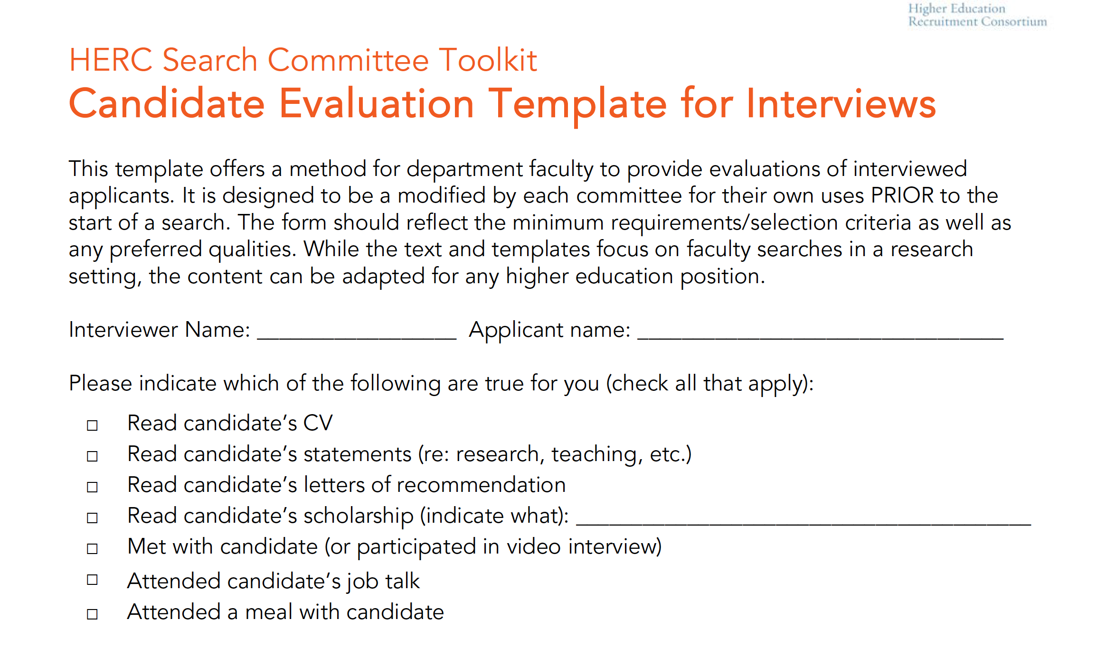

Slide 98
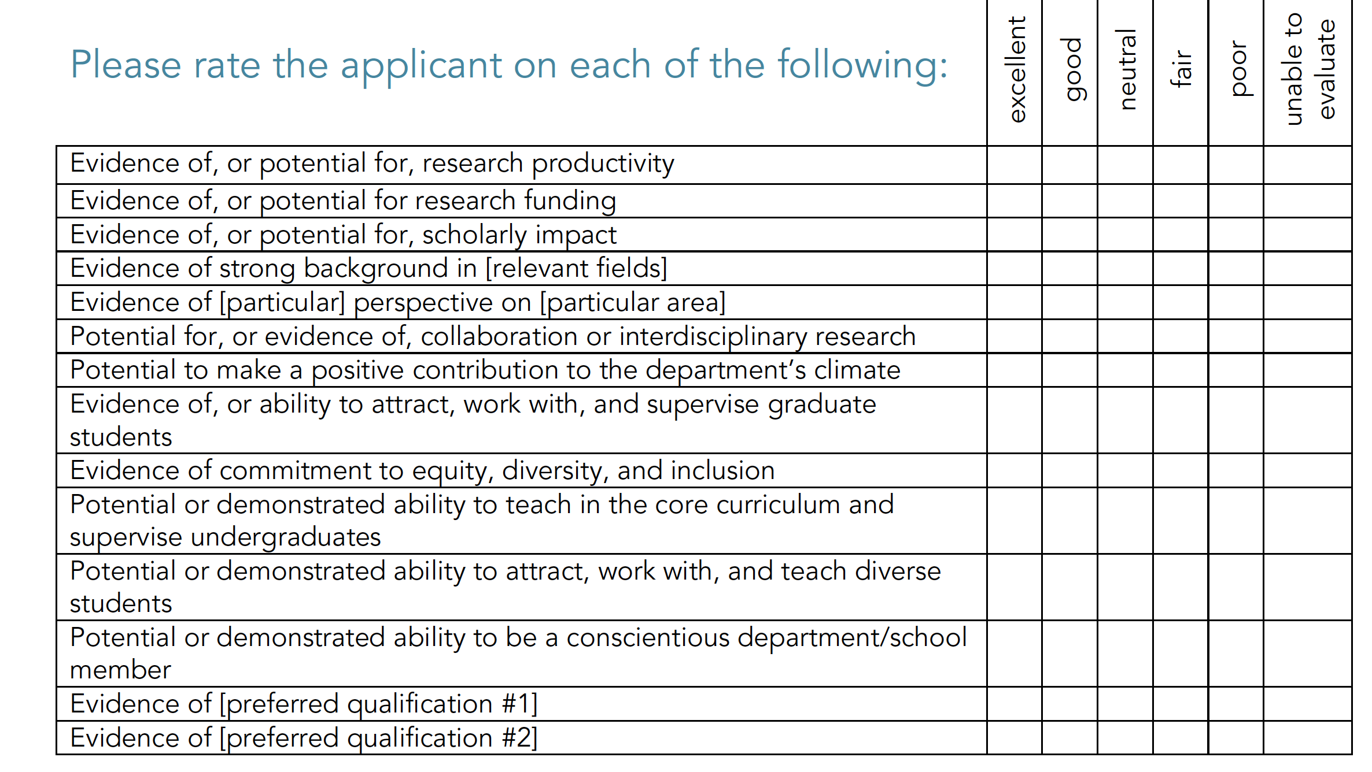

Slide 99
Competencies- UC Berkely
To assess commitment to diversity:
https://ofew.berkeley.edu/recruitment/contributions-diversity/rubric-assessing-candidate-contributions-diversity-equity-and

Slide 100
Example – Communication*
Level 1 | Level 2 | Level 3 | Level 4
Organizational pattern is not observable within the presentation. | Organizational pattern is intermittently observable within the presentation. | Organizational pattern is clearly and consistently observable within the presentation. | Organizational pattern is clearly and consistently observable and is skillful and makes the content of the presentation cohesive
Delivery techniques detract from the understandability of the presentation, and speaker appears uncomfortable | Delivery techniques make the presentation understandable, and speaker appears tentative | Delivery techniques make the presentation interesting, and speaker appears comfortable. | Delivery techniques make the presentation compelling2 , and speaker appears polished4 and confident
Insufficient supporting materials make reference to information or analysis that minimally supports the presentation or establishes the presenter’s credibility/authority on the topic. | Supporting materials make appropriate reference to information or analysis that partially supports the presentation or establishes the presenter’s credibility/authority on the topic. | Supporting materials make appropriate reference to information or analysis that generally supports the presentation or establishes the presenter’s credibility/authority on the topic. | A variety of types of supporting materials make appropriate reference to information or analysis that significantly supports the presentation or establishes the presenter’s credibility/authority on the topic.
Purpose is absent; the presentation does not seem to know what it is about. Unifying principles do not exist. | Purpose is understandable but is neither reinforced nor memorable; purpose and evidence are generally aligned. | Purpose is clear and consistent; purpose and evidence are appropriately aligned. | Purpose is compelling, precisely stated, appropriately repeated, memorable, and strongly supported. Purpose and evidence are aligned well.
Presenter cannot address basic questions about the topic or addresses them in a superficial manner. | Presenter can address some questions about the topic, but with minimal thought or knowledge. | Presenter demonstrates an ability to address most questions in a thoughtful and effective manner. | Addresses all questions in a manner that demonstrates a thorough command of the topic(s) of the presentation.
Based on the Association of American Colleges and Universities “Oral Communications VALUE Rubric.

Slide 101
Building Expectations: the key to motivating your staff
Notes:
Human resources are important AND costly!
A good hire can move your group to a new level; a hiring mistake can be devastating.

Slide 102
Goals important for the entire group
What is the goal of your unit
How does each person contribute to that goal
With the person next to you---discuss how your current supervisor talks about the group goals.
What is good about what they do
What could be improved

Slide 103
Expectations = Communication
Communication
Difficult Conversations

Slide 104
Domains of Work
Science
Interpersonal
Career
Do they have the skills to be successful at their level?
Am I helping them fit the dynamics of my group?
Will they be ready for their next step?

Slide 105
Stages of Work
Arrival
Integration
Working
Gap analysis/
training plan
Leaving
Guidance and support
Before we can plan, we must understand our goals.
Postdocs/Grads Postbacs

Slide 106
Handouts
Group welcome letter from an NIH lab
Documents from Entering Mentoring
Mentor-Mentee Compact (group welcome letter)
Undergrad (good for postbacs)
Grad student
Clinical Scholars
Getting started document from me
Not in document but may be useful, AAMC

Slide 107
Group Welcome Letters
Group Goals/Philosophies
Group meetings/Individual meetings
Core hours/ work policies/ group citizenship/deadlines
Policies (ie meetings/travel/ordering)
Ethics and other policies (like Civil)
Notebooks/data management
Authorship
Evaluations
Career development
Onboading

Slide 109
Distribution and Maintenance
When would you give this to someone new?
Before interview
At arrival
Follow-up
Revisions
Yearly, with whole group

Slide 110
Group Expectations
Some groups have set up documents to lay out expectations
In the documents I gave you what do you like, what hit your buttons?
Work in groups…what types of things would you like your document to cover?

Slide 111
Beyond the Group: Individual Arrival Plan
Long-term work goals
Career Goals (knowing things might change)
What do you expect them to get done in a 1,3,6-months to a year
Be specific- types of experiments, how to interact with group/collaborators/conferences/training/ presentations
Talking points to discuss your hopes and decide on realities

Slide 114
Developing Yearly Expectations
Performance Plans/IDPs/PMAPs
So, how do you talk about personal expectations?
How do you ensure that you do this more than once a year?
How do an individual’s time/roles change expectations?
Notes:
NOTE: In science the goal of the project (understand the role of metal ions in binding and cleavage) is NOT what we mean here….this is how you are going to talk about the steps to get here.

Slide 115
Individual Development Plan
Individual: Unique research/training/career goals of each person
Development: Improvement / development needed
Plan: Specific steps rather than a random walk
Must reflect work, interpersonal, career
Should be initiated by the person and (hopefully) discussed with boss

Slide 116
Annual Reviews
Reflection by worker and boss on the past year
Successes
Growth-potential
Every organization has specific formats

Slide 117
Review Success
Review goals from last year
What worked, always start with the positive
What did not work
Obstacles and solutions
Ask: What you as the mentor did well/could have done better
Set new goals
Clear documentation on milestones, how to improve, plans

Slide 118
Poor Performance
Performance = Ability x Motivation
Ability is the person's aptitude, as well as the training and resources supplied by the organization.
Resources
Training
Reassign
Release (must be in writing with at least 6-months (prefer 1-year)
Motivation is the product of desire and commitment.
Set goals
Motivation theory
Feedback (Appreciation/Coaching/Evaluation, frequency)
https://www.mindtools.com/pages/article/newTMM_80.htm

Slide 119
What should your group expect from you?
1. Be consistent with meaningful communication.
2. Give recognition and praise.
3. Provide feedback, mentorship, and training.
4. Create a work culture by design.
5. Create a safe space for failure.
6. Provide strong leadership and a clear vision
7. Hold yourself and others accountable
8. Demonstrate good problem solving
9. Avoid micromanaging
10. Be an effective decision maker
11. Put people first
12. Manage up, down, and sideways
13. Be honest
14. Be dedicated and balanced with your work and life
https://www.linkedin.com/pulse/14-simple-expectations-great-employees-have-boss-bernard-marr/

Slide 120
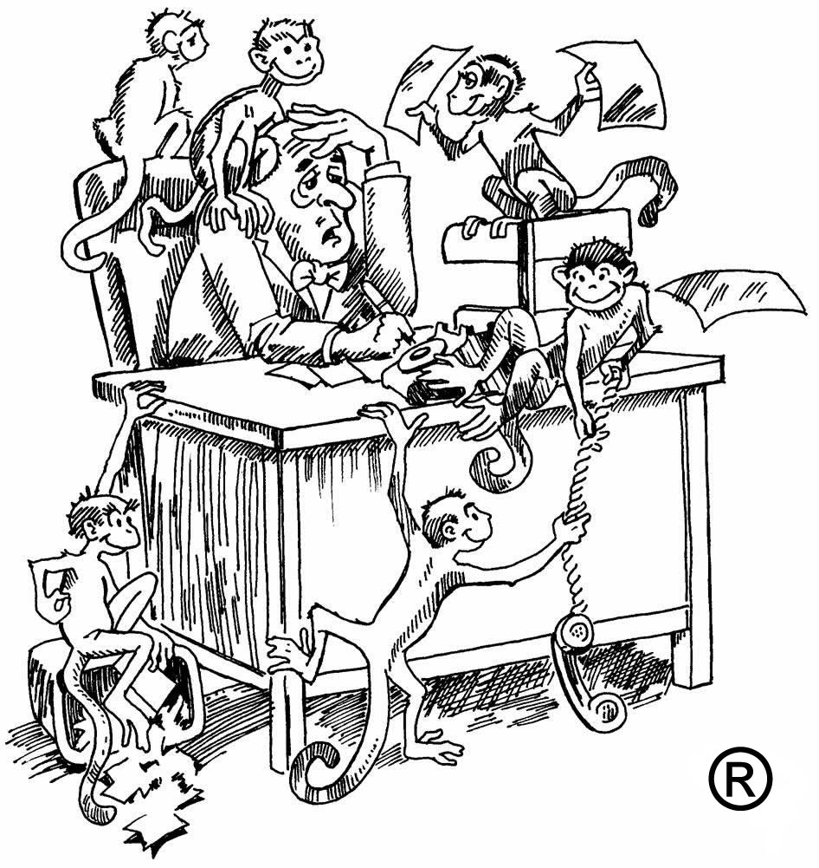
Setting expectations helps “Monkey Management”
You should let your employees own there own monkeys.—this is how you manage your time and expectations.
Boss-time (stuff your Boss needs)
System-time (stuff you need for peers/system)
Self-imposed time (stuff for you and your staff)
Oncken and Wass

Slide 121
Setting Expectations
Many many ways….but just do it
Don’t manage by telepathy
Can be written, oral, or both
Use MBTI and learning styles to guide
Stay on message when giving expectations, don’t confuse topics
Connect the expectations and goals to those of the greater group

Slide 122
Examples of expectations
Let’s set some expectations
New employee
Finishing postdoc
Employee with a new project
Employee with tight deadlines and multiple projects
Work with a partner to discuss 4 expectations of one of the above employees

Slide 123
Motivation and Fun

Slide 124
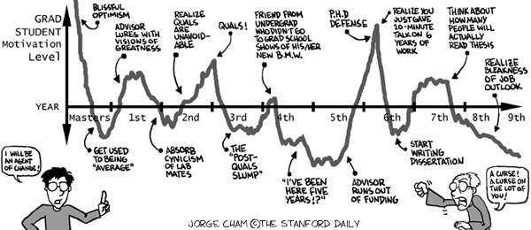
Motivation

Slide 125
What motivates you?
Goals (long/short term)
Evaluation
Rewards
Pressure
Autonomy
Mastery
Purpose
Appreciation
What de-motivates you?
Notes:
Here I will ask them to talk about what motivates them---then show the list (will also likely ask about what de-motivates them?

Slide 126
Motivation Theories
Herzberg – Two-factor theory
Pink– Autonomy, Mastery, Purpose Theory
Amabile and Kramer – Progress Theory
Reiss—Basic Desire Theory
Boyatzis et all – Positve/Negative Attractor Theory

Slide 127
Herzberg – Two-factor theory
Improving hygiene factors decreases job dis-satisfaction
Improving motivational factors increases job satisfaction
Status
Security
Career growth
Work environment
Salary
Organizational policies
Challenging work
Recognition
Responsibility
Purpose
Importance
Job satisfaction but not motivation
Motivation
Commitment
Notes:
If you have a hostile work environment, giving someone a promotion will not make him or her satisfied.

Slide 128
Daniel Pink Theory
Autonomy and self direction (think about Google)
Mastery of the subject (provide resources to help succeed)
Sense of purpose (feel ownership of the goal, feel that what is happening actually matters)

Slide 129
Amabile and Kramer – Progress Theory
Consistent forward progress– even small steps leads to staff that are creative, productive, and engaged
In science where goals are often big- how can we motivate staff with small goals?

Slide 130
Needs to learn and grow
Appreciation: To be seen/heard and matter
Coaching: To understand how to improve
Evaluation: To understand how they compare with others
Stone and Heen Thanks for the Feedback

Slide 131
Reiss—Basic Desire Theory
Acceptance, the need for approval
Curiosity, the need to learn
Eating, the need for food
Family, the need to raise children
Honor, the need to be loyal to the values of one's clan/ethnic group
Idealism, the need for social justice
Independence, the need for individuality
Order, the need for organized, stable, predictable environments
Physical activity, the need for exercise
Power, the need for influence of will
Romance, the need for sex and for beauty
Saving, the need to collect
Social contact, the need for friends (peer relationships)
Social status, the need for social standing/importance
Tranquility, the need to be safe
Vengeance, the need to strike back and to compete

Slide 132
Motivation and Neuroscience
Research by Boyatzis et al
Positive Emotional Attractor
arouses neuroendocrine systems that stimulate better cognitive functioning and increased perceptual accuracy and openness
People are open to thinking of new ideas and visions
Negative Emotional Attractor
Limits cognitive, perceptual and emotional openness and performance
people to defend themselves, and as a result they close down to avoid the stress

Slide 133
Recognize low motivation/procrastination
Filling your day with low priority tasks
Reading emails several times without starting work on them or deciding what to do with them
Sitting down to start a high priority task and almost immediately going to get a cup of coffee
Leaving an item on your To Do list for a long time, even though you know it’s important
Waiting for the “right mood” or “right time” to tackle the most important task at hand

Slide 134
Recognizing low motivation
Low motivation – if you are not interested in the project can you find a way to make it interesting or let it go
Lack of training – are you unprepared or incapable of completing the task? Seek guidance.
Perfectionism – are fears of doing a less than perfect job interfering with your productivity?
Fear of evaluation – Are you concerned about another individual’s response to your work?
Faulty assumptions – Did you underestimate the time it takes to complete the task?
Avoidance of negative experience – Do you simply hate the task?
Notes:
The key to procrastination is figuring out why you are putting off doing the task!

Slide 135
Is poor motivation actually poor delegation?
Why delegation goes poorly:
Giving up ownership is hard
We tend to delegate un-important tasks only
Perhaps we give people things that do not match their abilities
Lack follow-up on delegated tasks
In groups, talk about what you have seen effectively delegated.

Slide 136
Managing Knowledge Worker
Feedback on their work as peers
Mental space/dislike intrusions
Self-directed but need support
Continuous learners
Have own working schedules/may not be fond of deadlines
Highly mobile
Sebastiano Massaro--Nature Biotechnology article “Managing knowledge-intensive workers”

Slide 137
Do they have the ability?
Self: do they have the knowledge and the skills?
Others: are they holding your employee back? Are you part of the problem?
Things: anything in their physical environment?
People often forget the things holding them back
Think about a time where you were un-motivated due to lack of self/others/things

Slide 138
Ability ≠ Motivation
You have removed ability barriers…now check for motivation:
It sounds like we have an agreement, is there anything else in your way? Can I count on you to have this to me by Tues at noon?

Slide 139
Build the person
Psychosocial
Inner head tapes
https://www.youtube.com/watch?v=Mgb-kIZcOI4
What is the key message
How might this look in your staff?
How do you help you and your staff re-frame?
Offer career-related support
What would that look like?

Slide 140
Create an environment where people help each other
McK report and book (Giver’s Take All)
The amount of help a group’s members give one another is among the strongest predictors of group effectiveness. Building a “giver culture” pays.
To build this culture you have to know how to ask for something

Slide 141
Lastly on motivation
You first have to understand what you need right now:
1. to get the work done?
2. to build a relationship?

Slide 142
There May Be Bumps Along the Way
Enthusiastic
beginner
Disillusioned
learner
Cautious
performer
High
Achiever
Competence
Low
Some
Moderate
High
Confidence
High
Low
Variable
High
Needs
Direction
Support
Support
Independence
Adapted from Ken Blanchard, Self Leadership and the One Minute Manager

Slide 143
What are the needs of your staff?
Good Communication
Stated Expectations and Feedback
Job-related support
Career-related support
Psychosocial support

Slide 144
Action Planning
What 2-3 things can you do differently now?
What situations will you handle differently?
What obstacles might you have to overcome and how?
What will you do once at your new job to continue to be a great manager?

Slide 145
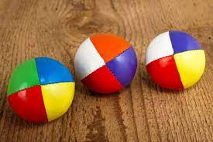
Let’s Put it All Together

Slide 146
Resources
Books: Crucial Confrontations (Conversations), Becoming a Conflict Competent Leader, TypeTalk at Work, Goleman EQ books, Learned Optimism, HBR Management Essentials
www.hhmi.org/labmanagement for Making the Right Moves
BWF book, Staffing the Lab
Books including Entering Mentoring, At the Helm, Motherhood: The Elephant in the Laboratory, Leadership in a Diverse and Multicultural Environment, Academic Scientists at Work, etc
A variety of websites including the NIH OITE, the NPA, Science Careers, The Chronicle of Higher Education, newfacultysuccess.com, Forbes

Slide 147
NIH OITE Resources For You
Watch prior OITE Career Workshops (www.training.nih.gov)
Read the OITE Careers blog
Join the NIH Intramural Science Linked-In group for lots of useful information about NIH and science careers
Connect with me on Linked-In (no Facebook please)
Join the Alumni database if you previously trained at NIH
Email me at conlanlo@mail.nih.gov

Slide 148
Some Books/TED Talks I Like
Emotional Intelligence: Why It Can Matter More Than IQ; Dan Goleman
Primal Leadership: Learning to Lead with Emotional Intelligence, Daniel Goleman, Richard Boyatzis, and Annie McKee
Learned Optimism: How to Change Your Mind and Your Life ; Martin Seligman
Self-Compassion: The Proven Power of Being Kind to Yourself; Kristin Neff
Daring Greatly: How the Courage to be Vulnerable Transforms the Way We Live, Love, Parent and Lead; Brené Brown
Taking the Leap: Freeing Ourselves from Old Habits and Fears; Pema Chodron
Everyday Bias: Identifying and Navigating Unconscious Judgments in Our Daily Lives, Howard Ross
Thirteen Things Mentally Strong People Don’t Do; Amy Morin
Becoming a Conflict Competent Leader, Craig Runde and Tim Flanagan

